Slide 1

Yelp Review Machine Learning
Chuyang Chen
Fiona Fei
Joanna Tang
Zoey Zhou

Slide 2
Agenda
01
02
Business Problem
Data Analysis & Preparation
03
04
Machine Learning Models
Project Execution
Cross-Platform Evaluation
Review authenticity
Focus oriented outcome
Data Cleaning, EDA, Text preprocessing, Class Weight
Logistic Regression, Random Forest, Linear SVM
Model Design, Execution Timelines, Storage Optimization

Slide 3

01
Business Problem

Slide 4
Business Problem
Cross-platform Evaluation
Review Authenticity
Focus Oriented Outcome
Fake reviews are misleading for customers and unfair to restaurant
Customers value specific aspects more than other aspects
Food posts on other social media could not be evaluated in the Yelp rating system

Slide 5
Business Objectives
Enlarge review dataset
Predict rating and evaluate reviews from other platforms
Improve rating authenticity
Identify fake reviews
Provide various review aspects
Visualize factors contribute to rating

Slide 6
Executive Summary
Nowadays, both consumers and merchants are relying on review sites such as Yelp when genuine feedback for business is needed. This project aims to predict customers’ ratings by analyzing their reviews about the restaurant on different platforms, detect fake reviews in comments, and analyze key factors that influence customers’ preference on restaurants.
The problem, binary classification for textual data is addressed through a combination of Yelp company reviews dataset, merchant information dataset, filtered fake review dataset, etc. These datasets are used to perform multiple machine learning algorithms and the success of these models will be compared using performance metrics such as F-1 score, AUC, etc.

Slide 7
Data Sources
Dataset Name | Source | Size
yelp_academic_dataset_checkin.json | Yelp Website | 398.3MB
yelp_academic_dataset_review.json | Yelp Website | 6.94GB
yelp_academic_dataset_tip.json | Yelp Website | 230.3MB
yelp_academic_dataset_user.json | Yelp Website | 3.68GB
yelp_business.json | Yelp Website | 124.4MB
fake_review_train.csv | StonyBrook | 169.1MB
fake_review_test.csv | StonyBrook | 24.2MB
Total: 11.57 GB

Slide 8
02
Data Analysis & Preparation
You can enter a subtitle here if you need it

Slide 9
Data Preparati0n
Data Loading
Select Column
Join Tables
Relabel
Text Only
Create cluster on GCP and Load data into GCP buckets.
Load data into RCC
Select columns from original dataset that can be used for business objectives.
Join datasets together by mutual columns.
Unify columns. E.g., relabel star rating 1 & 2 into ”bad”, and rating 4 & 5 into ”good”.
Only keep numbers from 1-9 and alphabets in text columns such as reviews.

Slide 10
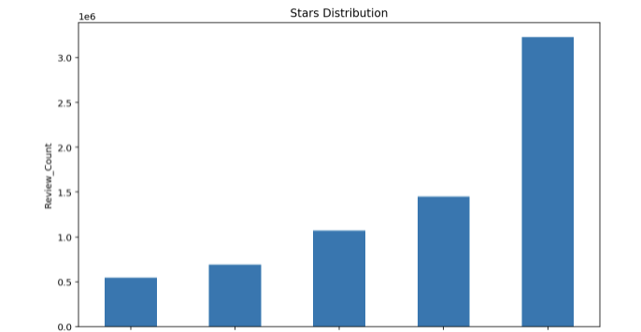
EDA – Stars Distribution
Interesting Insight:
The average number of reviews per business is: 44.86656
2-Star
3-Star
1-Star
4-star
5-Star

Slide 11
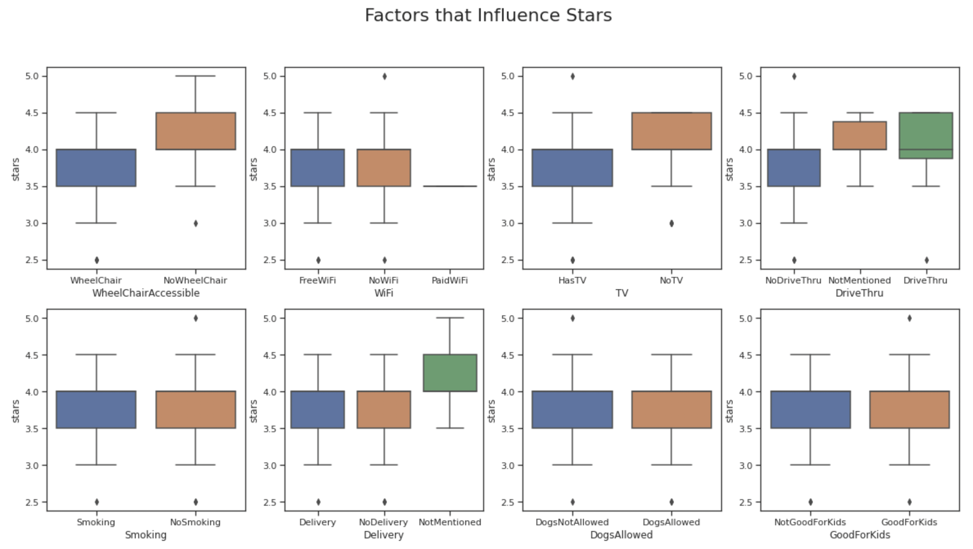
EDA – Factors that Influence Stars
Fiona

Slide 12
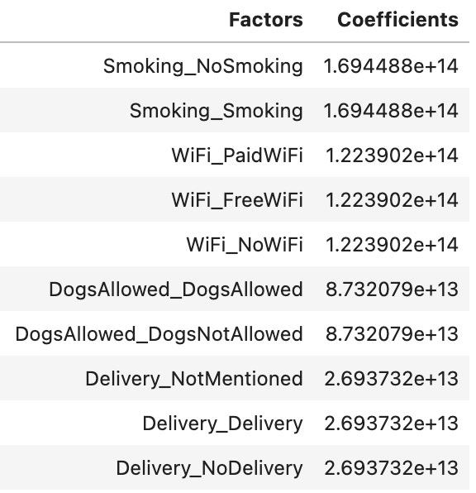
Which amenity should be improved by the restaurant?
Top Tags that lead to high ratings:
Smoking
Wi-Fi
Allow Dogs
Delivery

Slide 13
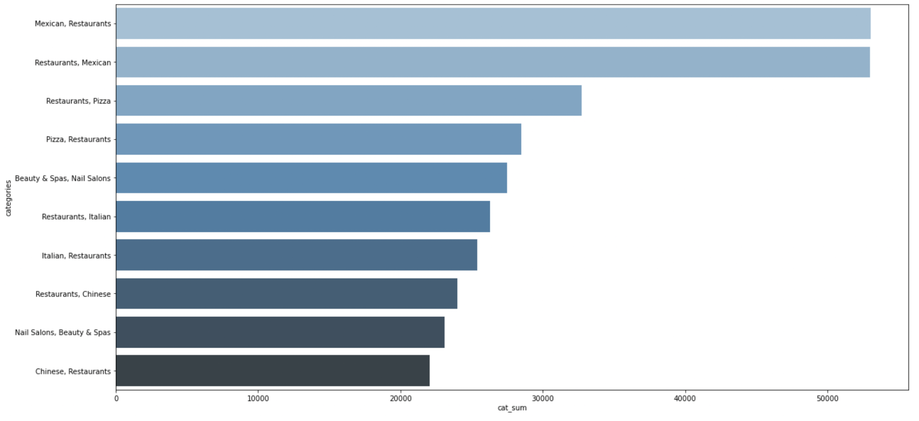
EDA – Most Popular Restaurant Categories
Interesting Insight:
The most popular restaurant category on Yelp is Mexican restaurants.

Slide 14
03
Machine Learning Problems

Slide 15
Do Customers like it or not?

Slide 16
Rating Prediction Process
Data Retrieval
Relabel
Build Pipeline
Train-Test
Split
Model Selection
Tokenization, stop-word removal, word2vec
Trained: 80%
Test: 20%
Logistic Regression, Random Forest, Linear SVM
Business_Id,
Date,
Stars,
Review
Stars 1,2: 0
Stars 3: Remove
Stars 4,5: 1

Slide 17
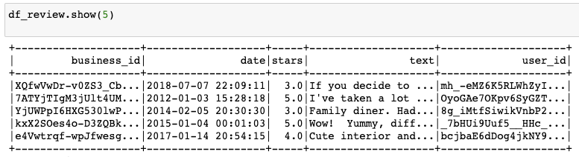
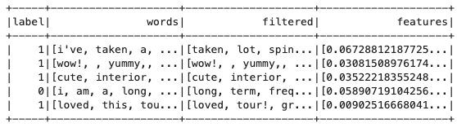
Input Data
Implement Pipeline

Slide 18
Binary Classification
 | Logistic Regression | Random Forest | Linear SVC
Accuracy Score | 0.94744 | 0.86156 | 0.94625
F-1 | 0.94729 | 0.84716 | 0.94711

Slide 19
K-Fold Cross Validation
Apply 3 Fold Validation on pre-processed data
AUC=0.9277
Select Model with the highest accuracy: Logistic Regression

Slide 20
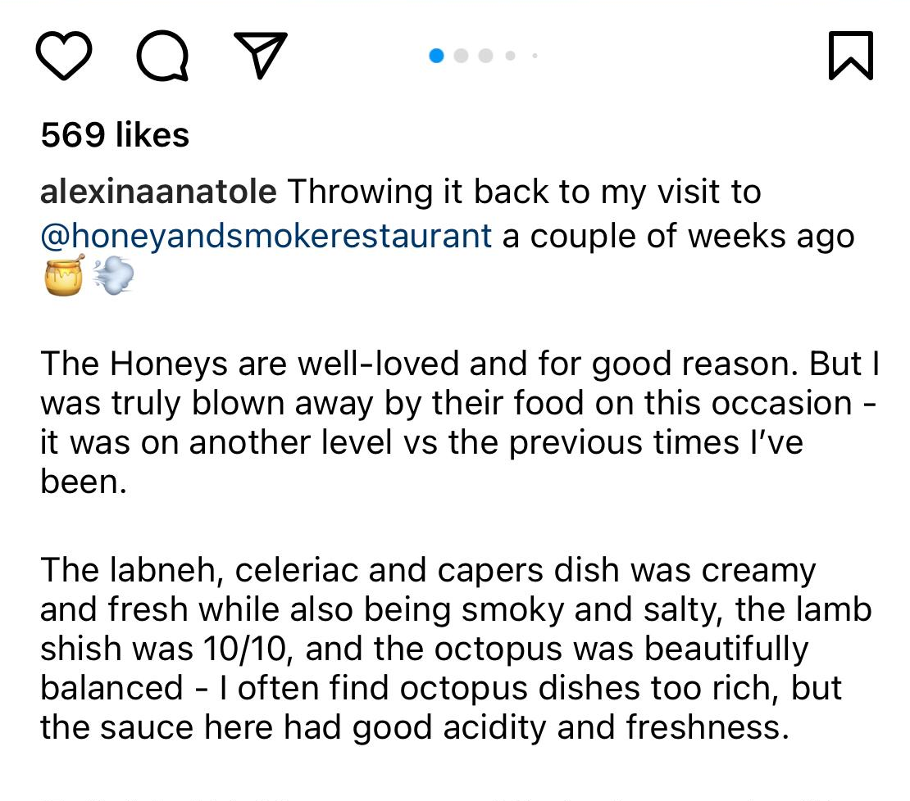
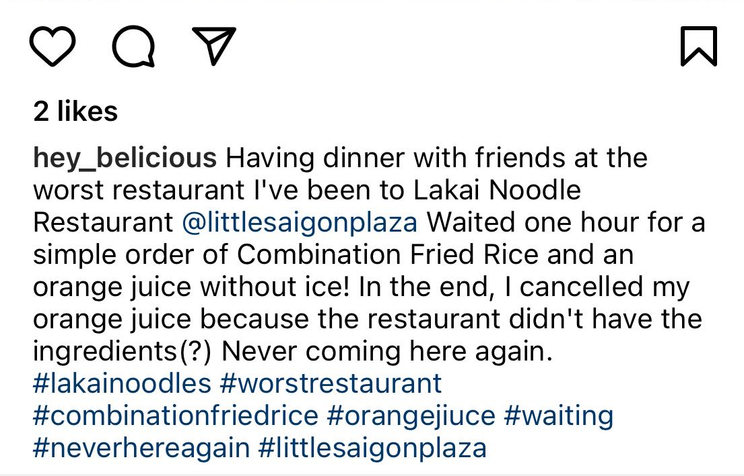
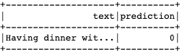
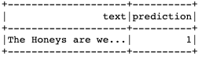
Do Customers Like it or Not?

Slide 21

Can we trust the review?
？

Slide 22
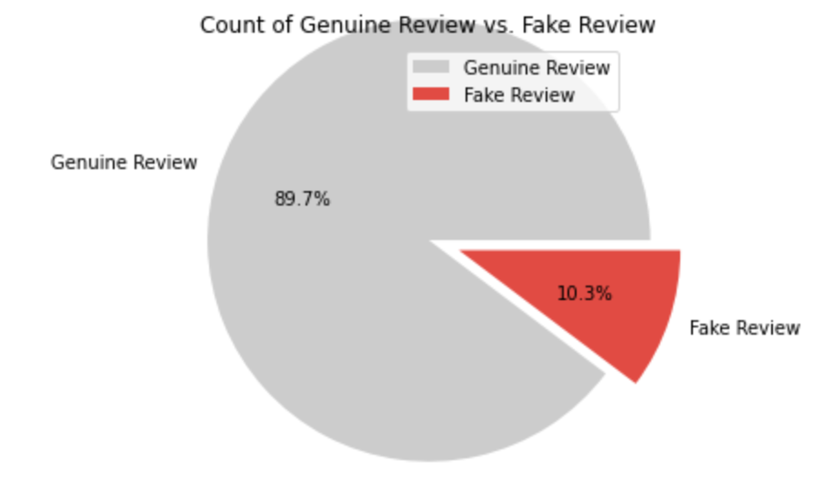
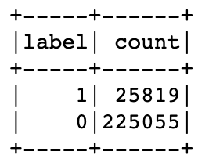
Imbalanced Data
Count of Genuine Review vs. Fake Review

Slide 23
Handle Imbalanced data
Method 1
Oversampling :
Adds more copies of the minority class, in our case is adding copies of the fake review.
Might lead to overfitting problem
Under sampling:
Removes some observations of the majority class, in our case is the real review.
Might lead to underfitting and poor generalization
SMOTE (Synthetic Minority Oversampling Technique):
Uses a nearest neighbors' algorithm to generate new and synthetic data.
Introduce less bias compared to other methods
Unfortunately, PySpark doesn’t have this package
Class Weight:
Penalizes more on mistakes in minority class
Method 2

Slide 24
Fraudulent Detection Process
Data Retrieval
Build Pipeline
Train-Test Split
Imbalanced Data
Model Selection
Text Review, Label
Tokenization, stop-word removal,
TF-IDF
Trained: 80%
Test: 20%
Logistic Regression, Random Forest, Linear SVM
Resampling
Add class weight

Slide 25
Model Performance
 | Logistic Regression | Random Forest | Linear SVC
Under Sampling | Accuracy = 0.56 AUC = 0.57 | Accuracy = 0.85 AUC = 0.59 | Accuracy= 0.81 AUC = 0.59
Over Sampling | Accuracy = 0.72 AUC = 0.63 | Accuracy = 0.90 AUC = 0.62 Time taken: Very Long | Accuracy = 0.84 AUC = 0.61
Class Weight | Accuracy = 0.87 AUC = 0.64 Time taken: Short | Pyspark doesn’t support this function | Pyspark doesn’t support this function

Slide 26

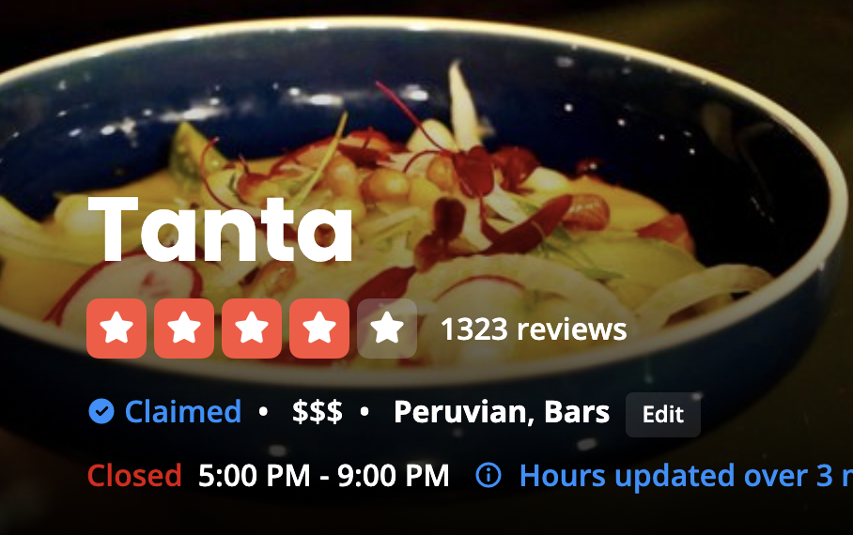
Let’s spot the fraud

Slide 27
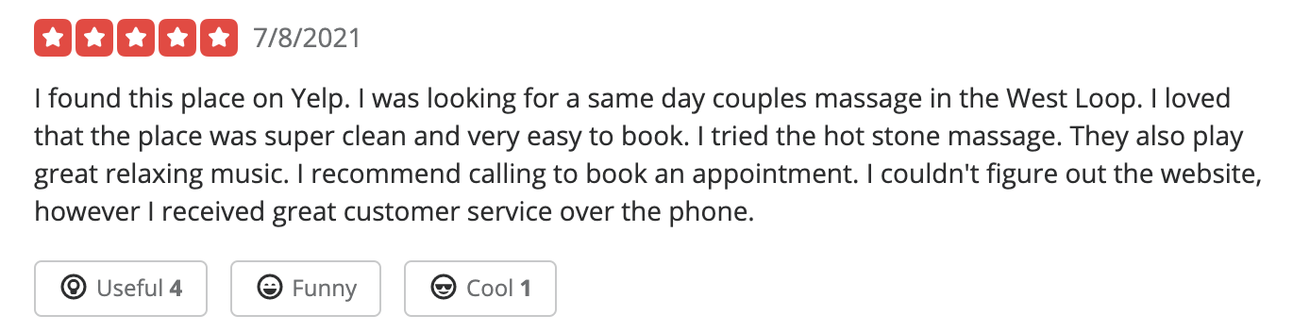
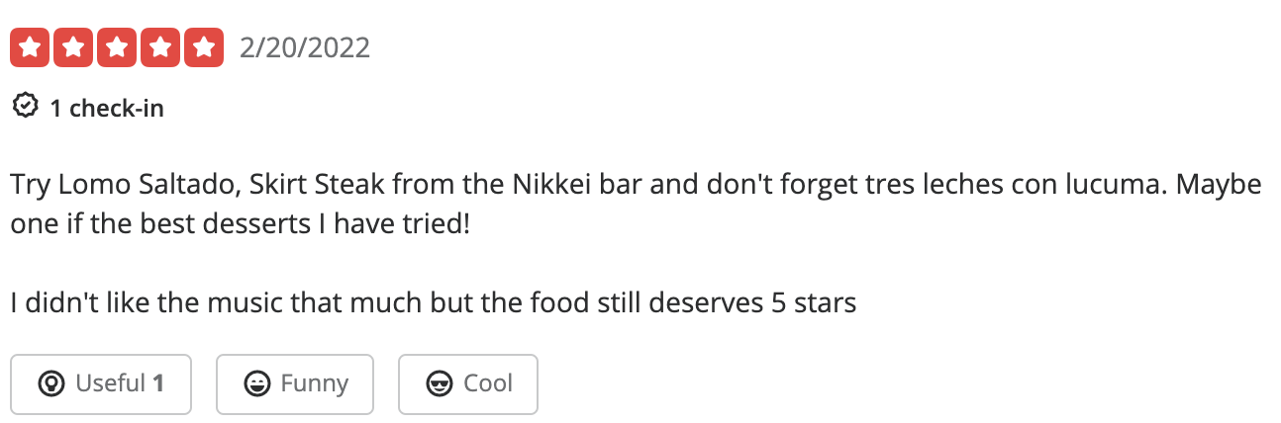
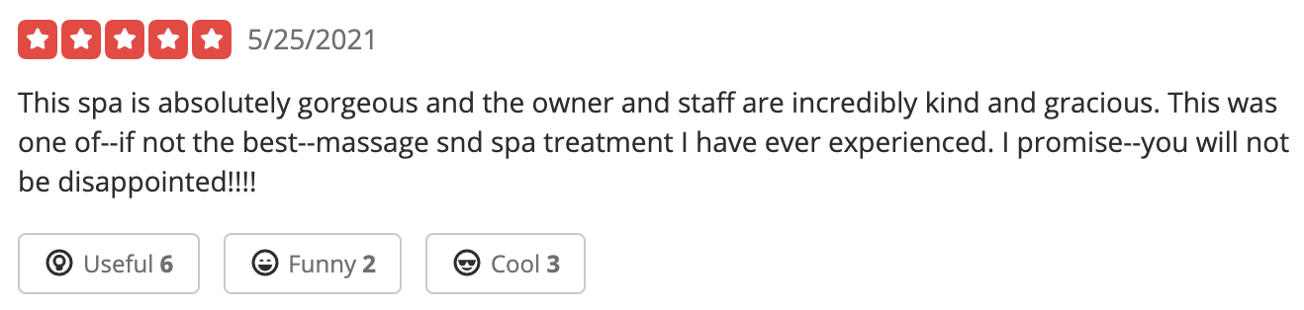
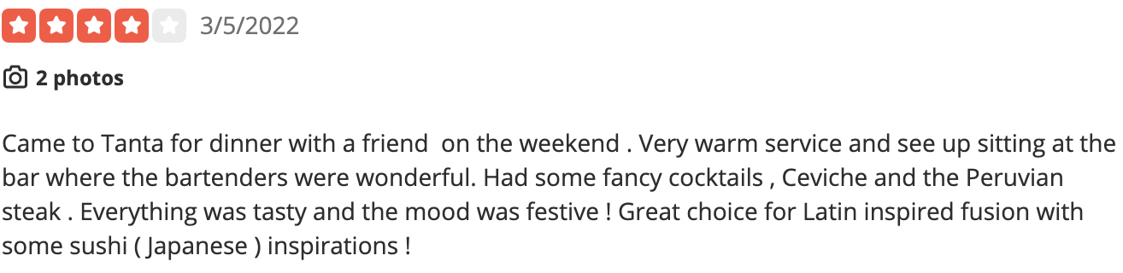
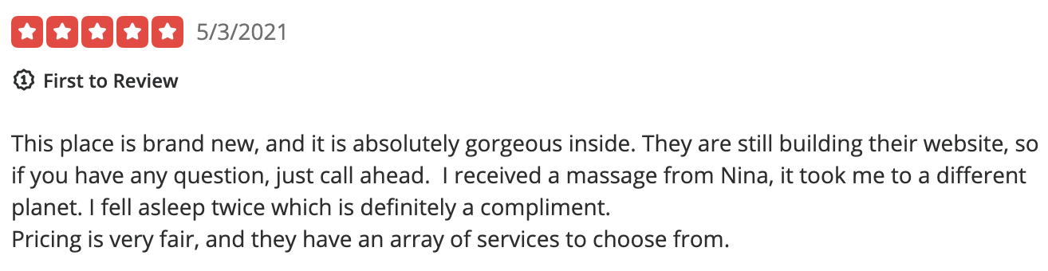
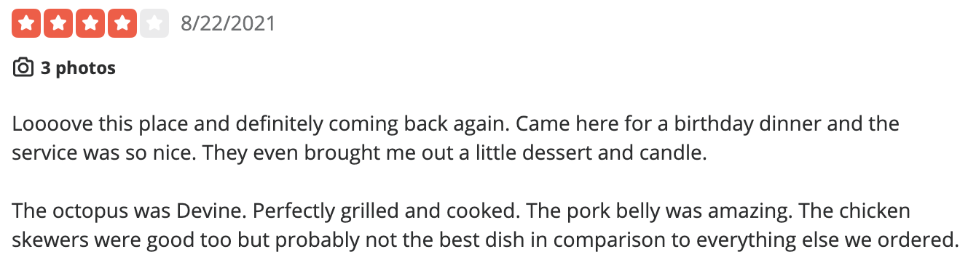
Let’s spot the fraud
Meet SPA’s Reviews:
Tanta’s Reviews:

Slide 28
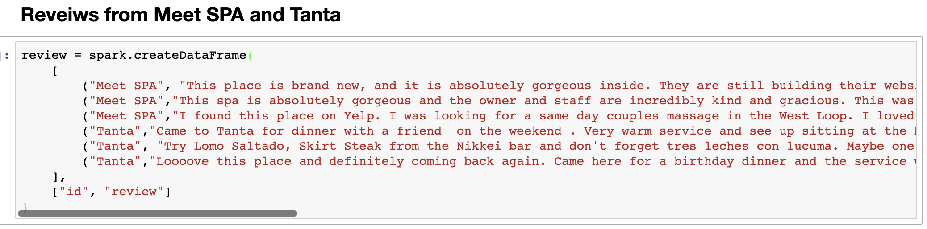
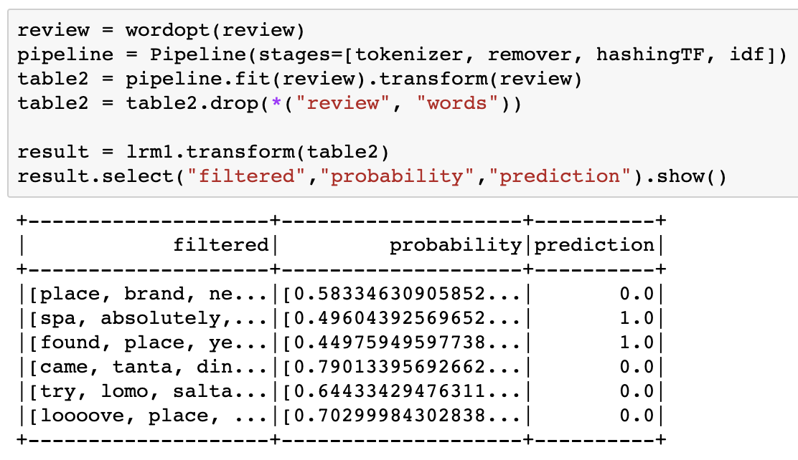
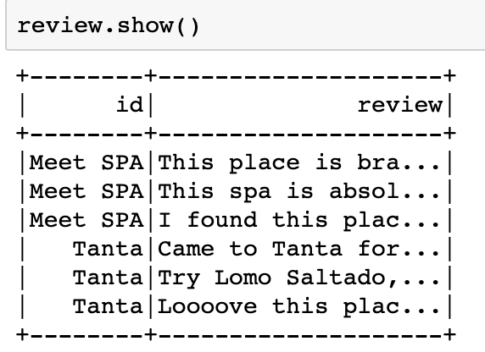
Let’s spot the fraud

Slide 29
Result
Meet SPA’s Reviews:
Tanta’s Reviews:
Fake Review
Fake Review

Slide 30
Which aspects should be improved by the restaurant?

Slide 31
Which amenity should be improved by the restaurant?
Top Tags that lead to high ratings:
Smoking
Wi-Fi
Allow Dogs
Delivery

Slide 32
Sentiment Analysis

Slide 33
Basic Sentiment Analysis - Data Processing
Main Dataset: yelp_academic_dataset_review.json
Retrieve data
& Relabel
Build Pipeline functions
Get Phrases
Top Freq - Visualization
- Select 'text', 'stars' column
- star 4 or 5 -> good reviews
- star 1 or 2 ->
bad reviews
- Tokenize
- Remove stopwords & punctuations
- Lemmatize
- Extract Noun phrases
- Get frequencies of each word
- Bar charts
- Word Cloud

Slide 34
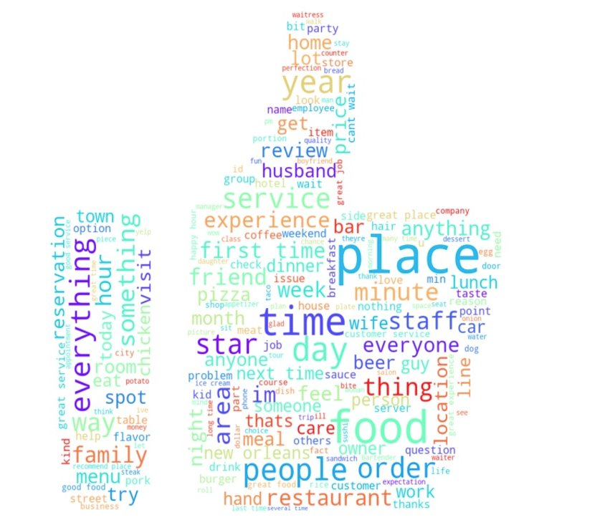
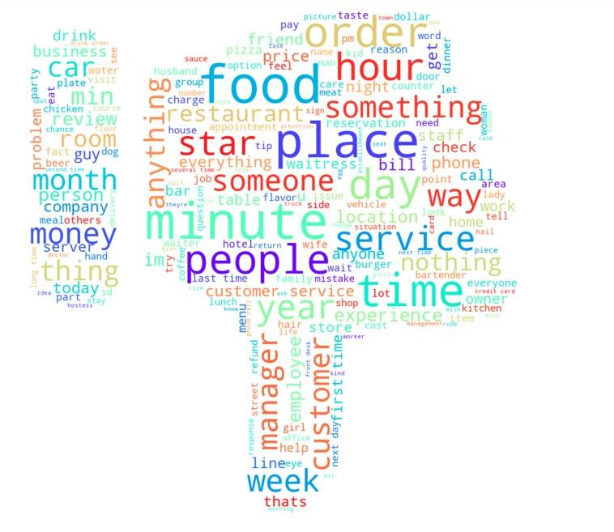
Good vs. Bad Review – Word Cloud

Slide 35
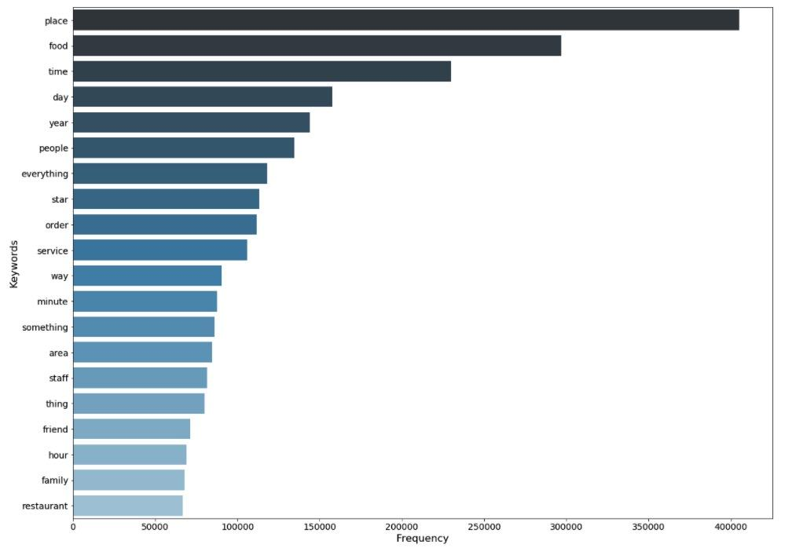
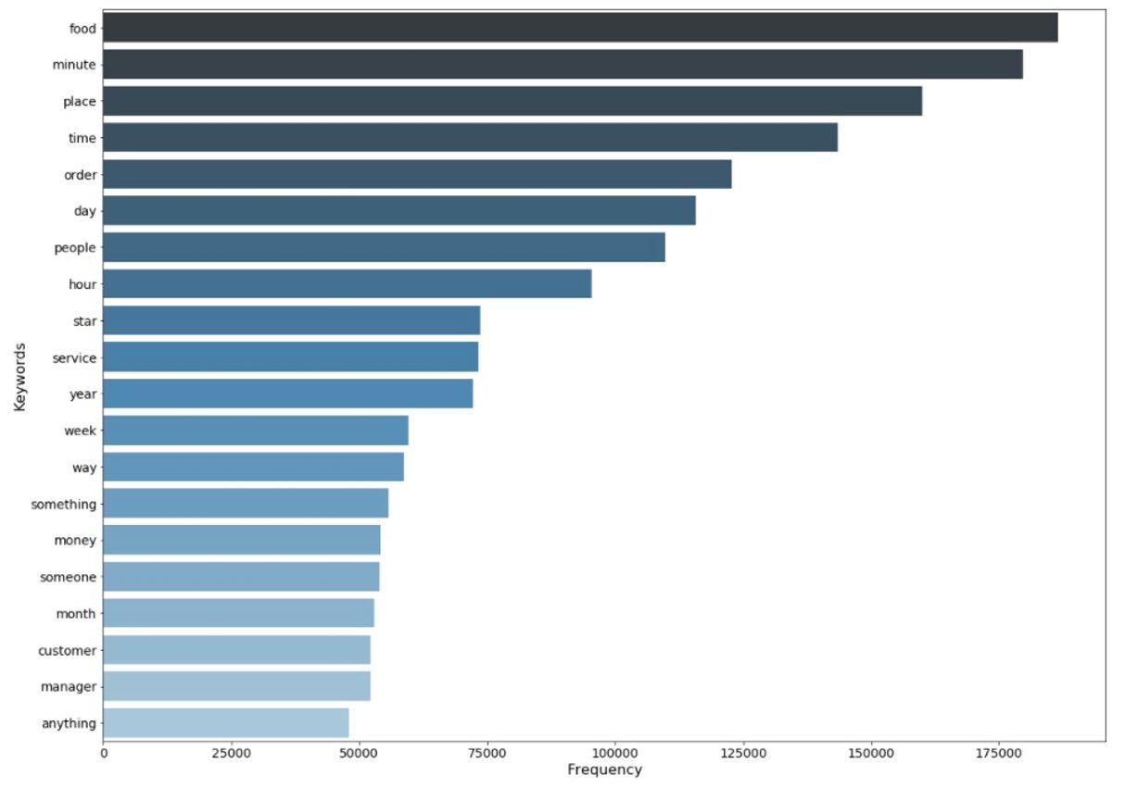
Good vs. Bad Review – Top 20 Keywords
Good review keywords
Bad review keywords

Slide 36
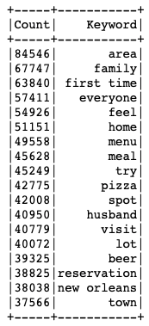
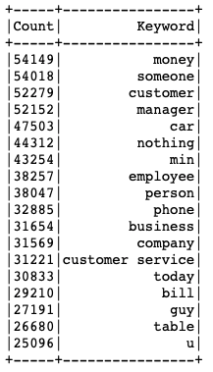
Good vs. Bad Spotlights
Good：
- Great environment
- Suitable for family gathering
- Great location (nearby home, in-town, etc.)
- Food quality
Bad:
- Expensive/not worth the money
- Customer service
- Parking
- Long waiting/no tables

Slide 37
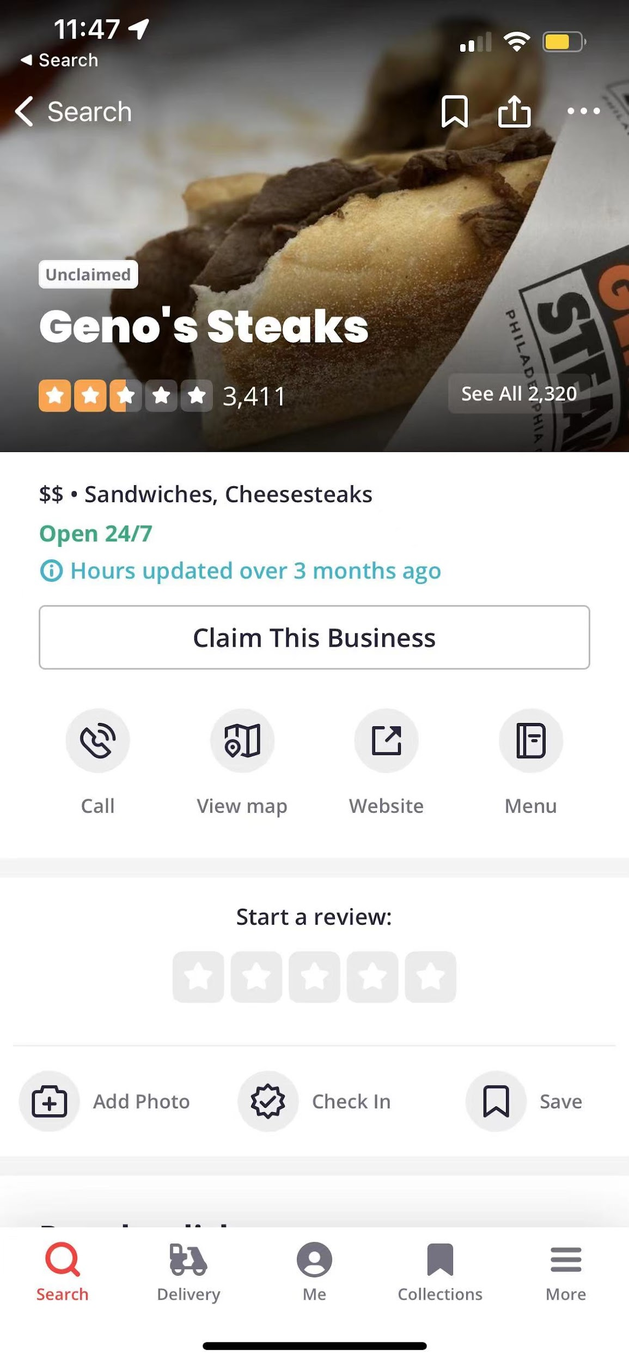
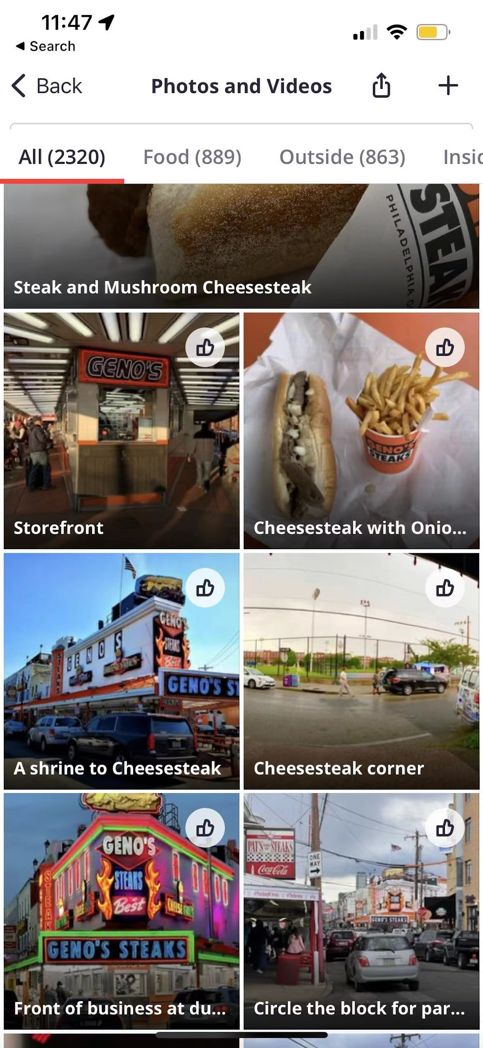
Aspect Based Sentiment Analysis
Name: Geno's Steaks
Business_id: IkY2ticzHEn4QFn8hQLSWg
Average stars: 2.5
Total reviews: 3411
Location: Philidelphia, PA

Slide 38
Aspect Based Sentiment Analysis - Data Processing
Main Dataset: customer reviews of Geno's Steaks
Retrieve data
Build Pipeline functions
Fit Model & Transform
Visualization
- Select all review from the restaurant (star 1-5)
- DocumentAssembler
- SentenceDetector
- Tokenizer
- WordEmbedding
- NER Model
- NER converter
(from sparknlp)
- Get the sentiment result (NEG or POS) of each word/phrase
- NerVisualizer
- Dataframes

Slide 39
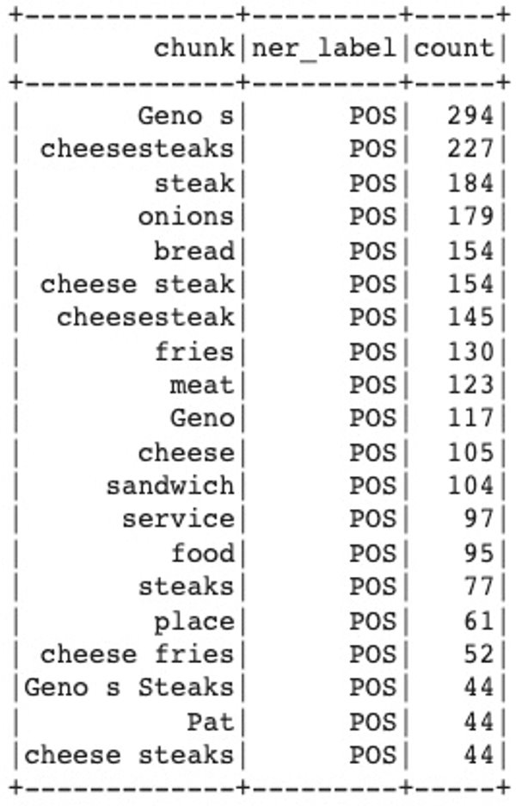
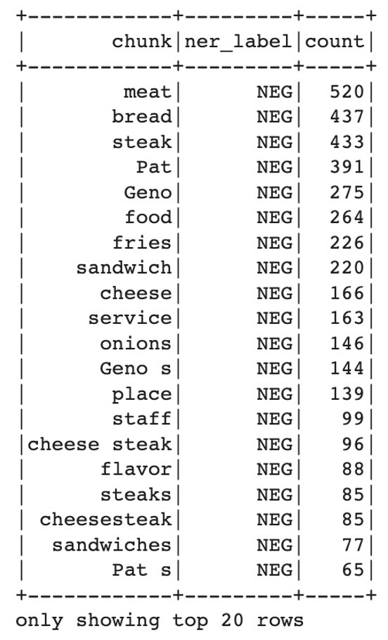
Positive vs. Negative top 20 words/phrases

Slide 40
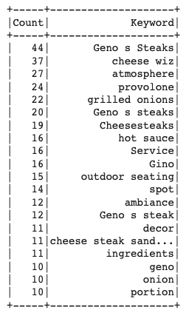
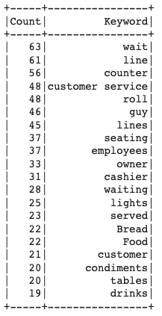
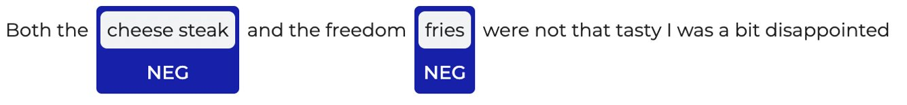
Positive vs. Negative Spotlights
POS：
- Steaks!!
- Cheese (provolone)
- Atmosphere, environment, decor
- Portion of the food
NEG:
- Long lines and waiting
- Customer services (employees, counter, cashier)
- Foods & drinks
Sample visual
for single comment

Slide 41
04
Project Execution

Slide 42
Reflection
Execution Timelines:
Set weekly or bi-weekly checkpoints to make sure there are enough time for testing and improvement.
Storage Optimization:
Distributed work into both GCP and RCC.
Assigned shifts based on group members’ schedule to maximize the availability of memory in kernel.
Improvement:
Implemented SMOTE for better performance in imbalanced dataset.
Add other features such as reviewer’s behavior (e.g., multiple reviews uploaded at the same time from a single reviewer can be considered as fraudulent)

Slide 43

Thank You!
Any Questions?
Please keep this slide for attribution.

Slide 44
Reference
https://colab.research.google.com/github/JohnSnowLabs/spark-nlp-workshop/blob/master/tutorials/streamlit_notebooks/ABSA_Inference.ipynb

